Slide 2
The Problem
“The concert tickets are sold out? I wish I had known earlier.”
“My competitors undercut my prices – I wish I could keep track of their products.”
“I just missed that dream job – I can’t afford to miss the next one”
Who has the time to check 100’s of websites every day?

Slide 3
The Solution
Femtoo automates the manual process of checking for webpage changes
Track any part of any webpage
Every 30 minutes, 24 x 7, 365 days of the year
Choose when and how to be notified
Graphs and reports of content changes
Share your trackers with the world

Slide 4
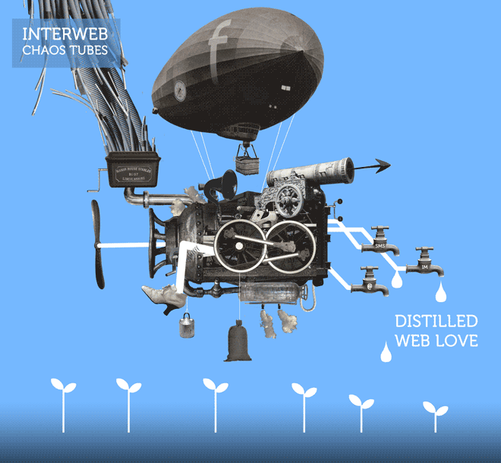
Demonstration

Slide 5
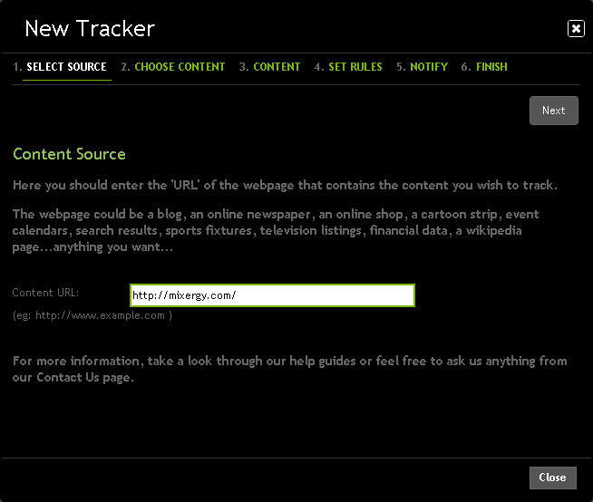
Offline Demo 4: wizard step 2

Slide 6
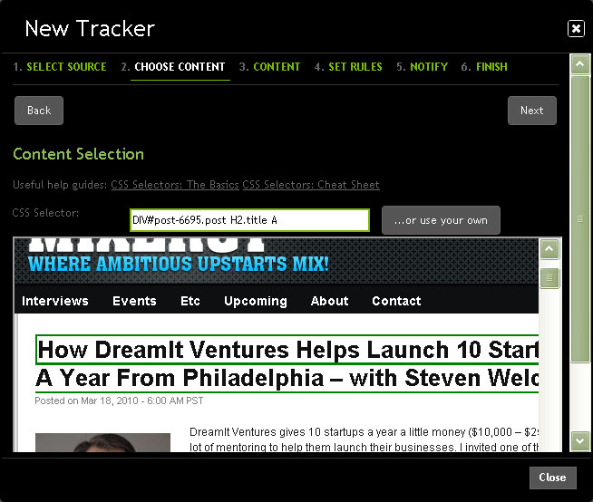
Offline Demo 5: wizard step 3

Slide 7
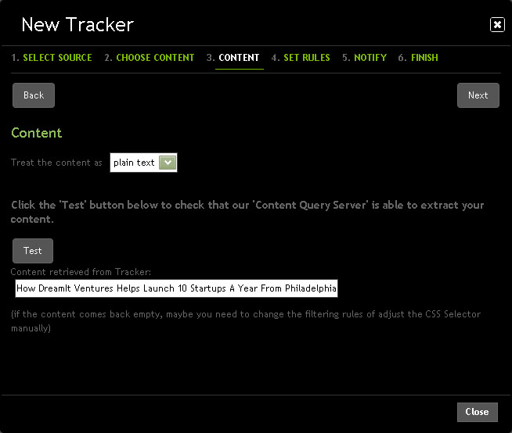
Offline Demo 6: wizard step 4

Slide 8
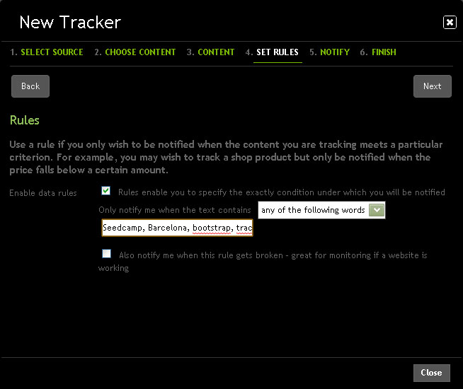
Offline Demo 7: wizard step 5

Slide 9
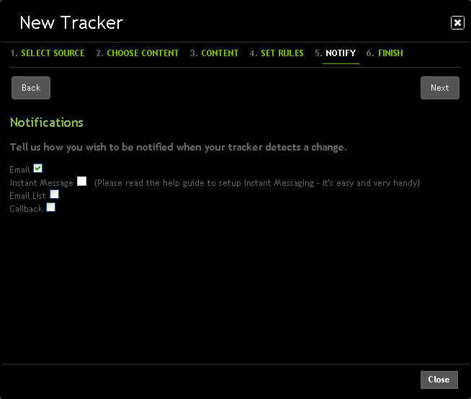
Offline Demo 8:wizard step 6

Slide 10
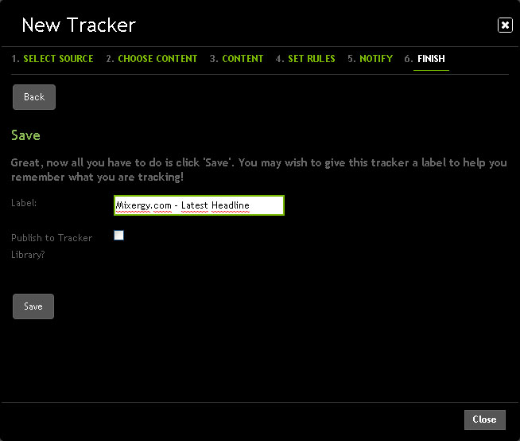
Offline Demo 8:wizard step 6

Slide 11
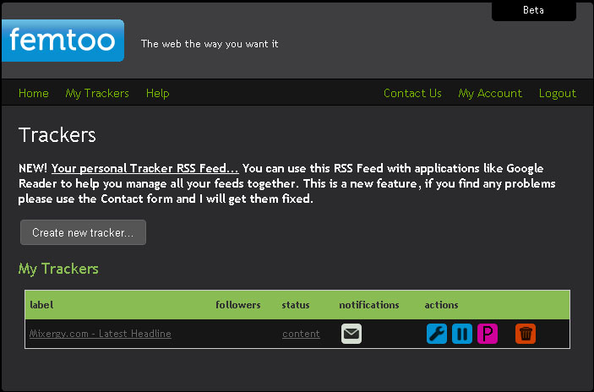
Offline Demo 9: tracker list, with tracker content popup

Slide 12
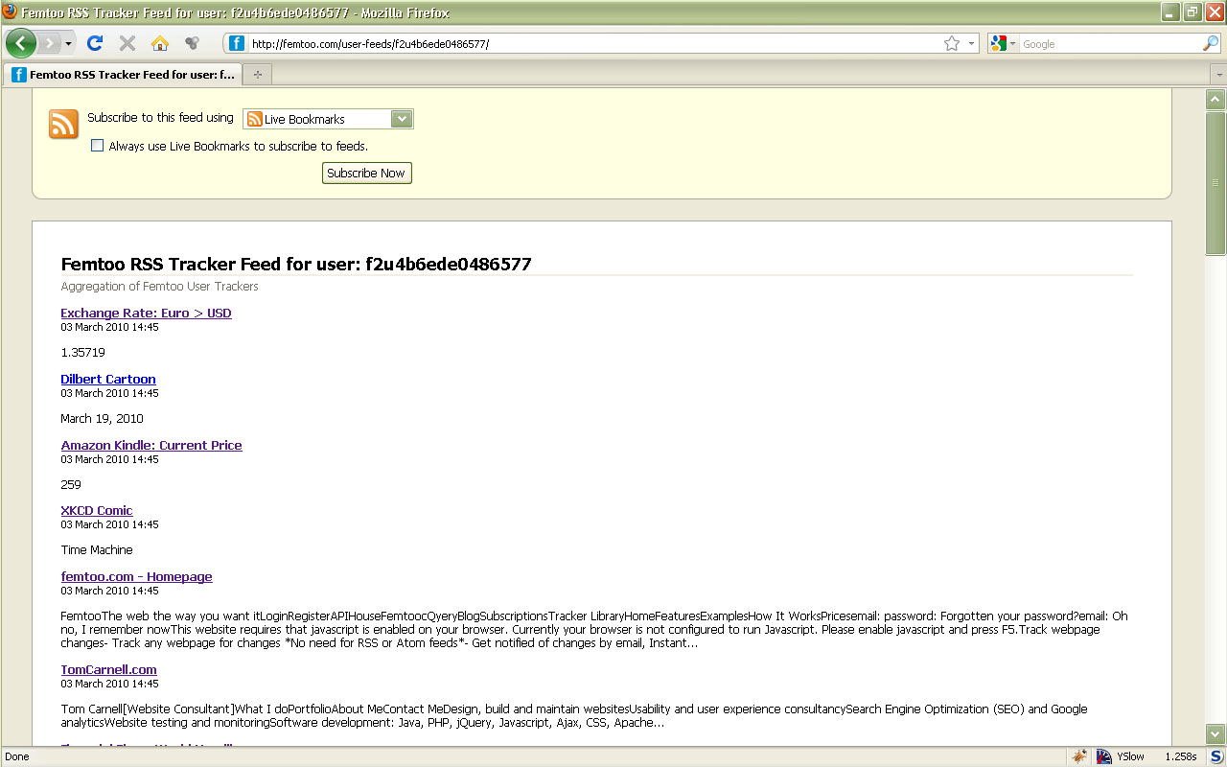
Offline Demo 12: madrid temp 24

Slide 13
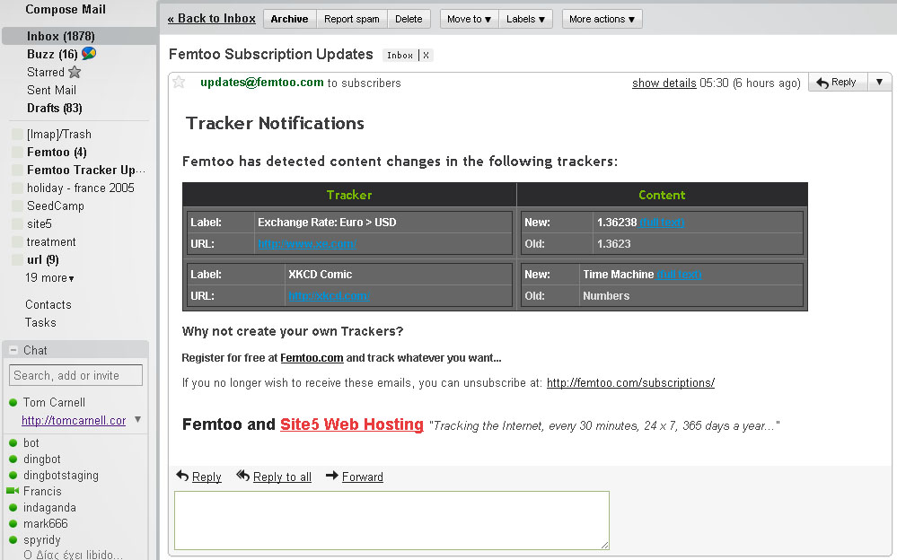
Offline Demo 11:tcarnell trackers with stats button

Slide 14
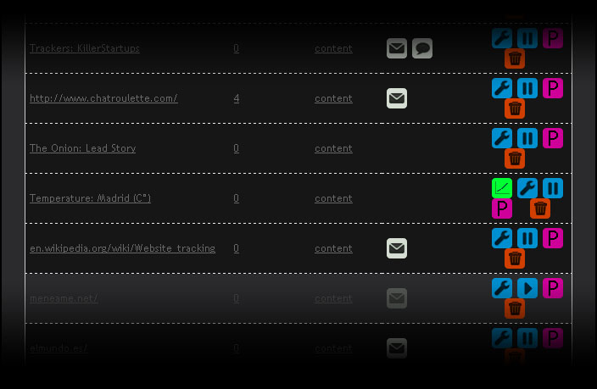
Offline Demo 14: BBC headlines 96 hours

Slide 15
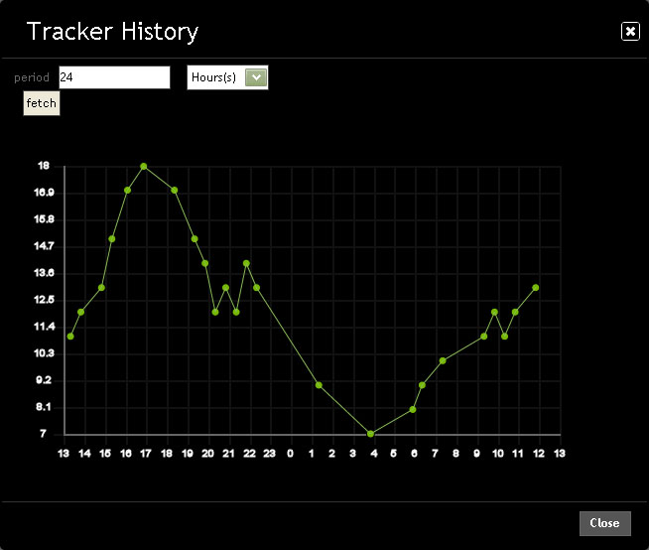

Slide 17
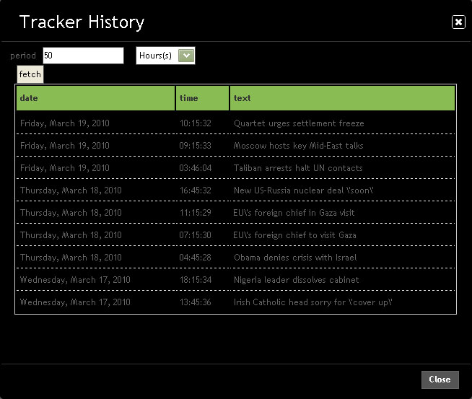

Slide 18
Lift Off!

Slide 19
Project startup
Used by friends and colleagues
Femtoo used as ‘site monitor’ for kontain.com (outperforms commerical software)
(March 2010)

Slide 20
First signs of growing user base and very positive user feedback
Implementation of user requested features (including RSS Tracker Feed)
2nd generation user-interface and improved content selection
(March 2010)

Slide 21
Femtoo reviews start appearing on the Internet - and they are good.
Google Analytics shows global user base and indicates a viral trend
Every 1 in 12 visitors signs up and creates at least 1 tracker
(March 2010)

Slide 22
Unsolicited interest in commercial use (including a Danish ecommerce site and & clicker.com)
Implementing Premium accounts
Investigating e-commerce opportunities

